Slide 1
Planning and design for child-friendly streets and public open spaces
ASHOK BHATTACHARJEE
Advisor, Clean Air and Sustainable Mobility,
Centre for Science and Environment
Session-VI: Plenary Session on Mobility & Open Space International Conference on Cities4Kids : Small Children, Big Cities - Urban95
2-3 February 2017 : Pragati Maidan, New Delhi

Slide 2
United Nations Convention on the Rights of the Child (CRC)
highlight the responsibility of the States to uphold the child's right to live in a safe, clean and healthy environment and the right to engage in free play, leisure, and recreation
A child friendly city or community is a place where children’s rights and needs are at the centre of good community planning and design.
It is place where adults listen to children and young people and take what they say seriously.

Slide 3
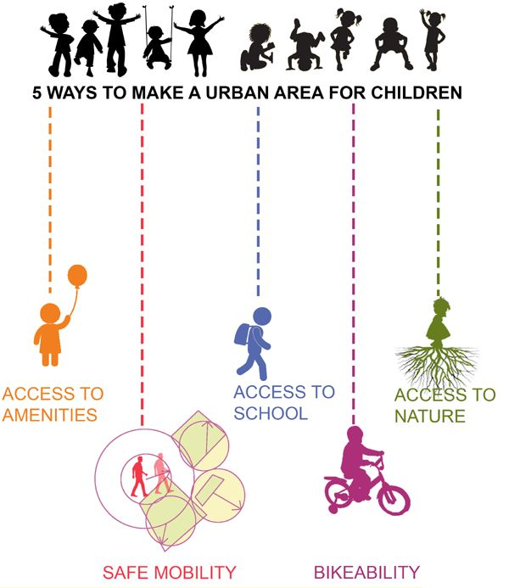

Slide 4
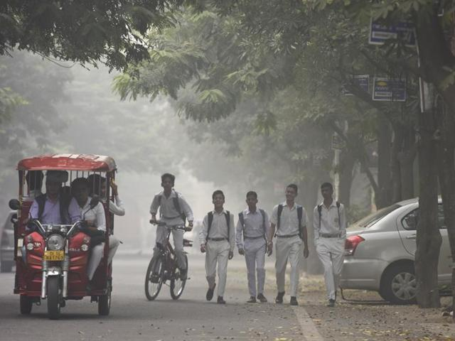
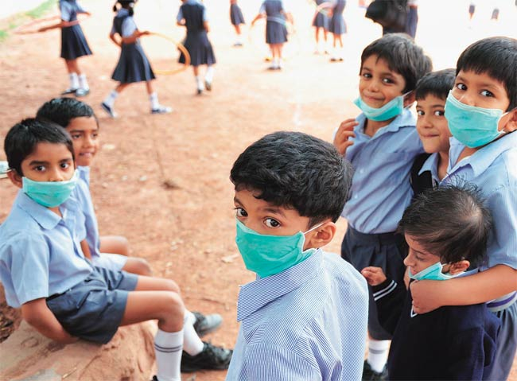
Situation
‘’Children’s airways, lungs and immune system are still developing, which makes them vulnerable to airway allergies, respiratory infections and irreversible lung damage,” said Anupam Sibal, senior paediatrician at the Indraprastha Apollo Hospitals.
“Pollution levels are toxic and my advice to parents is to keep younger children (ages 6 and below) home.” Krishan Chugh, director of paediatrics at the Gurgaon-based Fortis Memorial Research Institute said,
Delhi’s kids had 1.8 x more respiratory illnesses (sinusitis, running or stuffy nose, sneezing, sore throat and common cold with fever) and 2 x more lower respiratory illnesses.
‘’Children's] lungs are not fully developed until their late teens and they breathe more air per kilo of body weight. That means more harmful particles entering their body’’

Slide 5
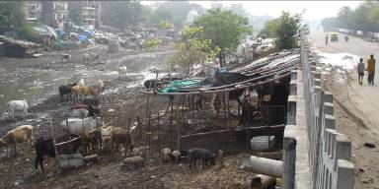
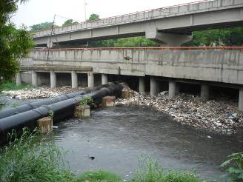
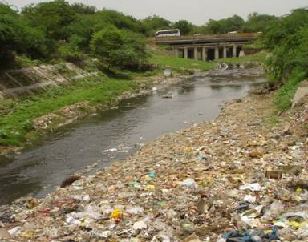
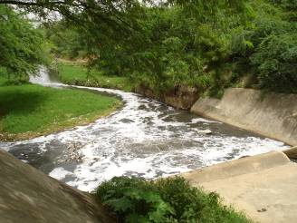

Slide 6
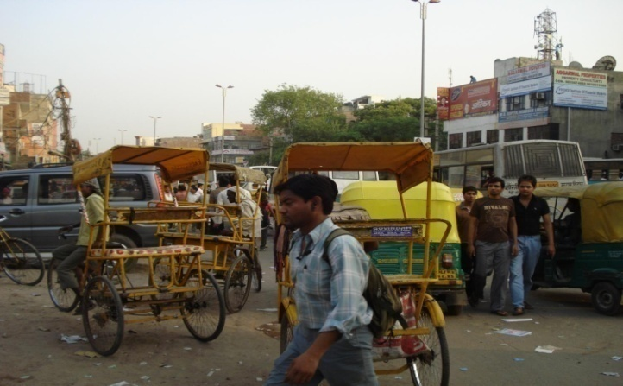
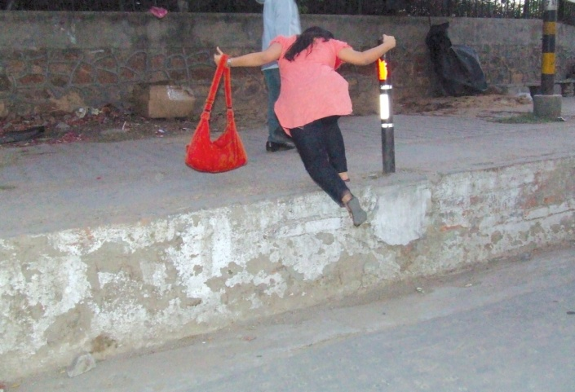
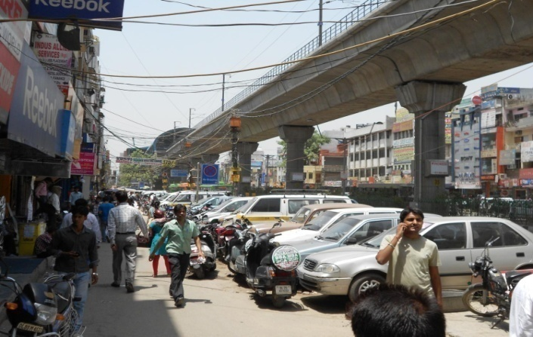
Physical barriers and restrictive mobility
Gated parks all around the city largely affect the outdoor active recreational needs of young children which are also not safe for other children.
Broken/encroached footpaths with physical barriers on roads and public open spaces safe walking affecting all section of people in general and children, differently able, elderly people in particular.
Opaque boundary wall with setbacks all around the property is restricting 'eyes on the street ‘ creating an unsafe mobility condition and concern for women safety in public spaces.

Slide 7
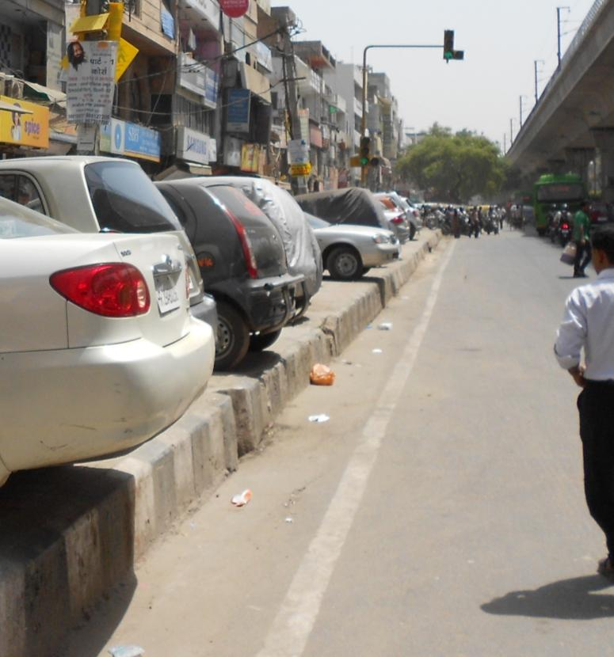
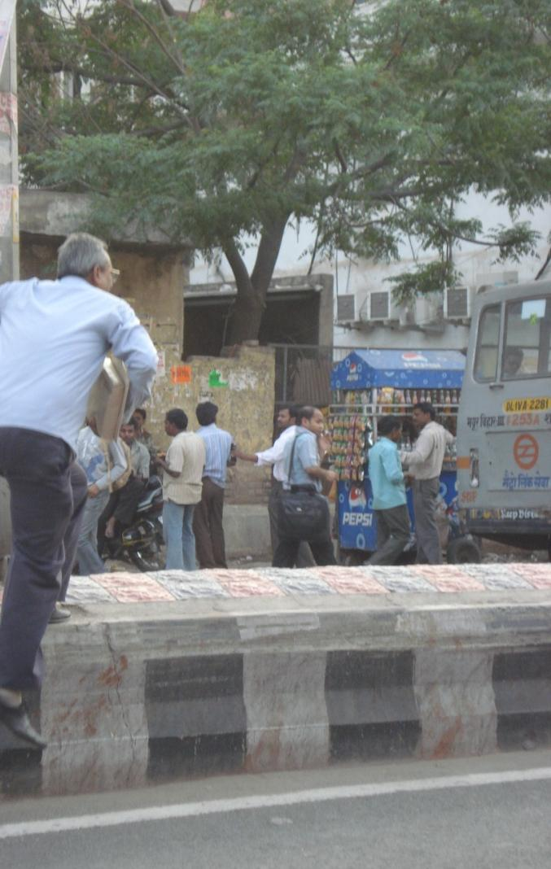
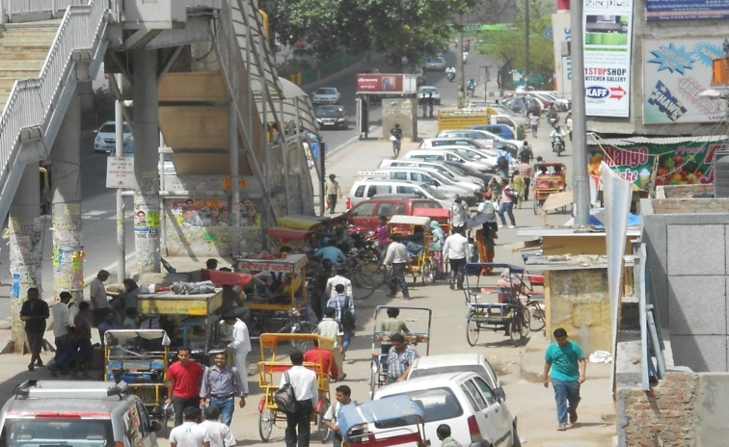
All playfields within school boundaries are again highly underutilized and inaccessible for the community/neighborhood people/children.
Need for utilization of such large underused land bank for community play ground.
Motorization of all streets with parking acting as accessibility barrier for open space utilization and mobility requirements of people between colonies and activities across the roads.
Pedestrians and cyclists are the worst victim of air pollution and accidents due to auto centric policy and sheer neglect of infrastructure for walking and cycling

Slide 8
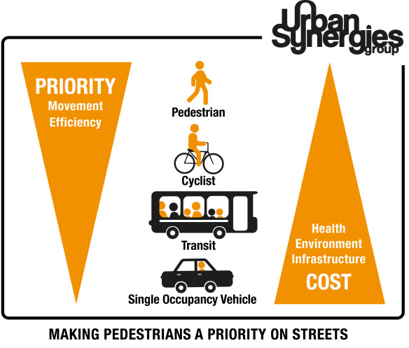
Land use planning at macro level should adopt a development pattern based on people centric function based approach with integrated road-green network .
Landscape planning at micro level in consultation with urban planners/designers should create a built environment with vibrant public open spaces.
BOTTOM UP APPROACH OF PLANNING
Safe mobility for pedestrians, cyclists and NMV users
Planning from neighborhood level
Pedestrian focused streets
Livable cities !

Slide 9
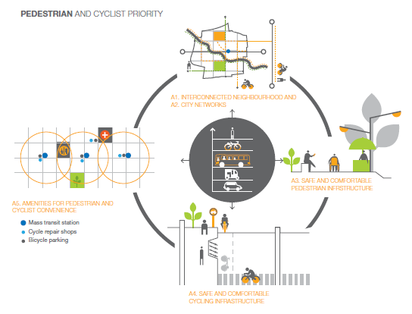
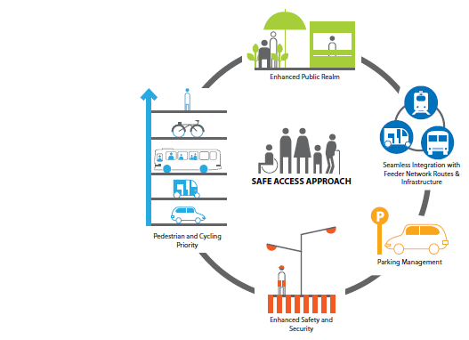
Inclusive approach towards NMT/ Pedestrian, Public transport networks
Non- Motorized transport Network – Approach
Pedestrian Network –
Safe access Approach

Slide 10
Consequences and Issues
Universal accessibility and Social equity
Poor air quality and health implications
Inactive/passive lifestyle and increased Non communicable diseases
Unsafe roads/public spaces and Women safety
Quality of public life and sense of belonging
Question
Whether landscape development will remain only as creation of ornamental gardens and beautifying the parks as designated in the layouts of development plan or extend to a wider level of engagement in the sustainable Urban development process by integrating open spaces with all recreational activities and mobility functions of people ?

Slide 11
Impact – measures and indicators
Accessibility - Walkable distance to schools parks, playgrounds
Safety - Fully segregated walkway, motor free streets/areas in the neighborhood/colonies
Security -- High Visibility , Active and Vibrant Public spaces
Air quality – Good Air quality level-(< 60mg/cum – PM2.5 and 100 mg/cum- PM10 in neighborhood.
Health – play, walk, cycle – active mobility.

Slide 12
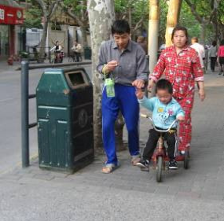
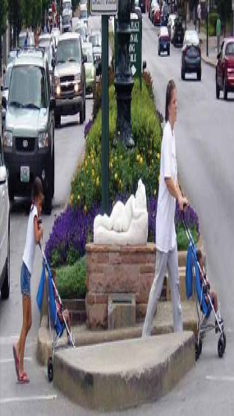
Universal Accessibility is required for all sidewalks, crossings ,parks, public spaces and amenities – for people using wheel chairs, strollers, walkers, crutches, handcarts, bicycles, aged people, visually or hearing impaired, and pedestrians with temporary mobility impairment or injury Children , elderly men and women

Slide 13
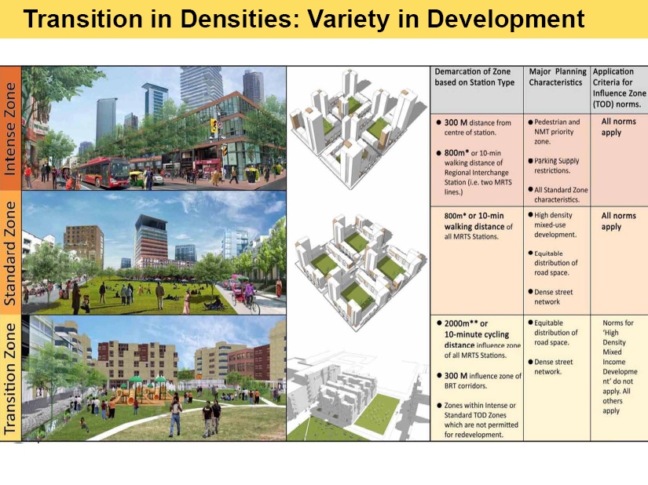
Planning and Development Strategies – a multi disciplinary approach
Present planning practice and process need to evolve from rigid segregated land use based development pattern to compact , organic and mixed use development
Entire built form and open space integration with mobility system define the character of the development form satisfying the activity and functional needs of the people.

Slide 14
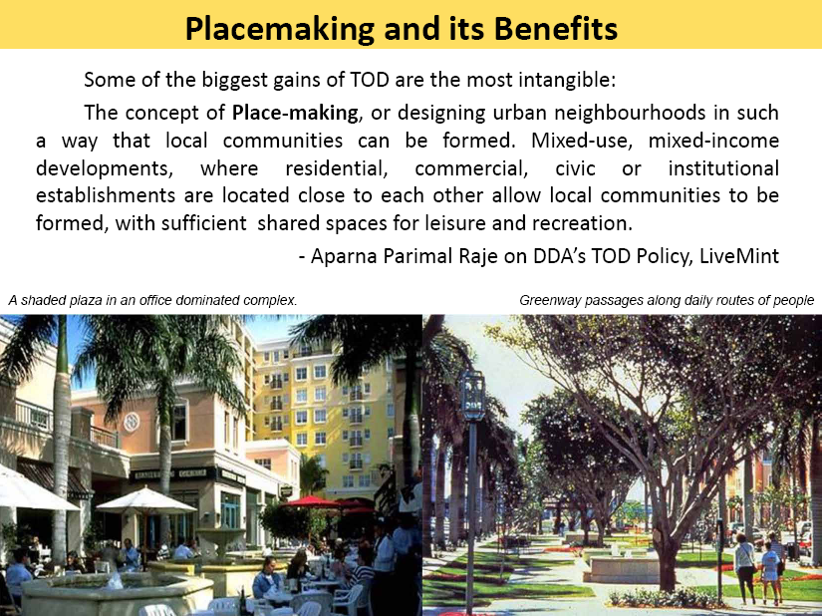
High Density- Mixed Income Development
Walking/cycling accessibility to public transport and public spaces in and around major commercial, office complexes, and other intensive land use areas with vibrant public activities and functions.
Developing greenways along unused/misused land under storm water drains etc and integrating them with entire road grid for developing eco mobility corridor/network.

Slide 15
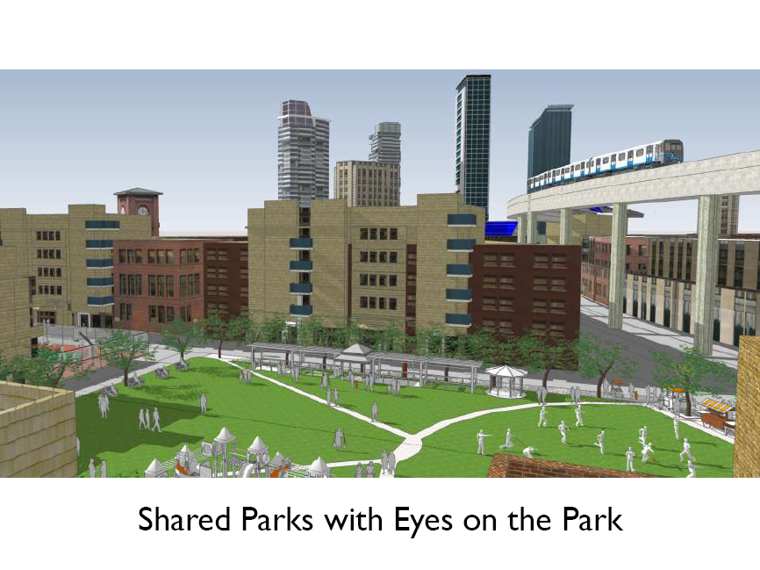

Slide 16
Action proposed- Integrated urban open space
i) All streets- public space need to be designed in detail and developed with all street components to facilitate commuters in general and pedestrian/cyclist in particular and developed/retrofitted to promote walking/cycling and public transit use.
ii) All public open spaces around public buildings, shopping complex, terminals, monuments, metro stations, parks/playgrounds with large public/pedestrian concentration need to be designed and developed as pedestrianized vibrant public spaces (squares/Plazas) integrated with its surrounding built forms to enhance quality public life removing all physical barriers.
iii) All natural storm water drains are to be taken up for stoppage of sewage inflow, cleaning and redeveloping its wide land base as greenways with eco mobility corridor to provide walking/cycling movement and cross connectivity between colonies along the corridor.

Slide 17
Recommendations
All city major roads should include segregated Cycling /Walking space finally linking neighborhoods to ensure safe movement .
Maximum 50% of the r/w should be reserved /developed for motor vehicular carriageway and the rest should be reserved/developed for walkways/footpaths, non motorized
All neighborhoods should have more car free vibrant and active public space with ease of accessibility by children and differently able people
All barriers in the form of physical and visual access to a public open space/building to be removed with very limited no of buildings having transparent barrier for security.
All public open spaces to have universal accessibility

Slide 18
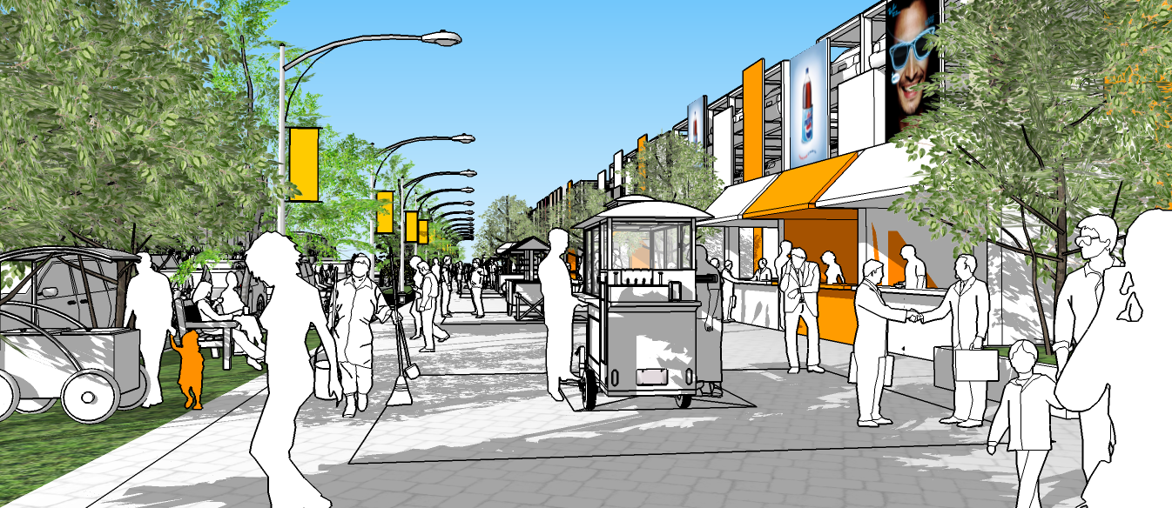

Slide 20
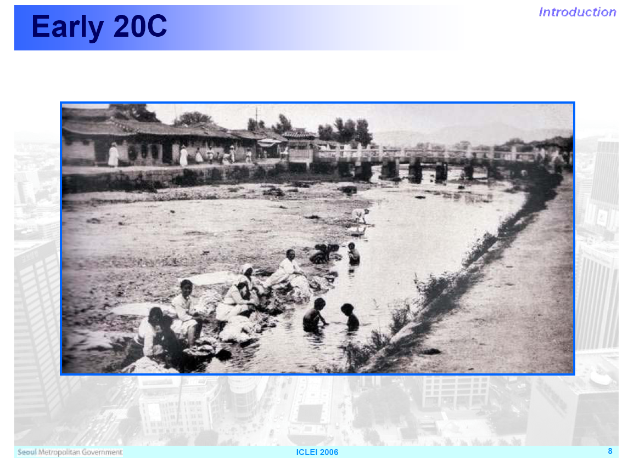

Slide 21
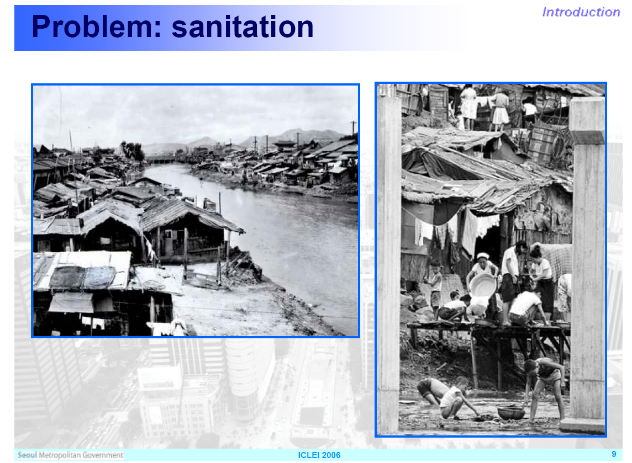

Slide 22
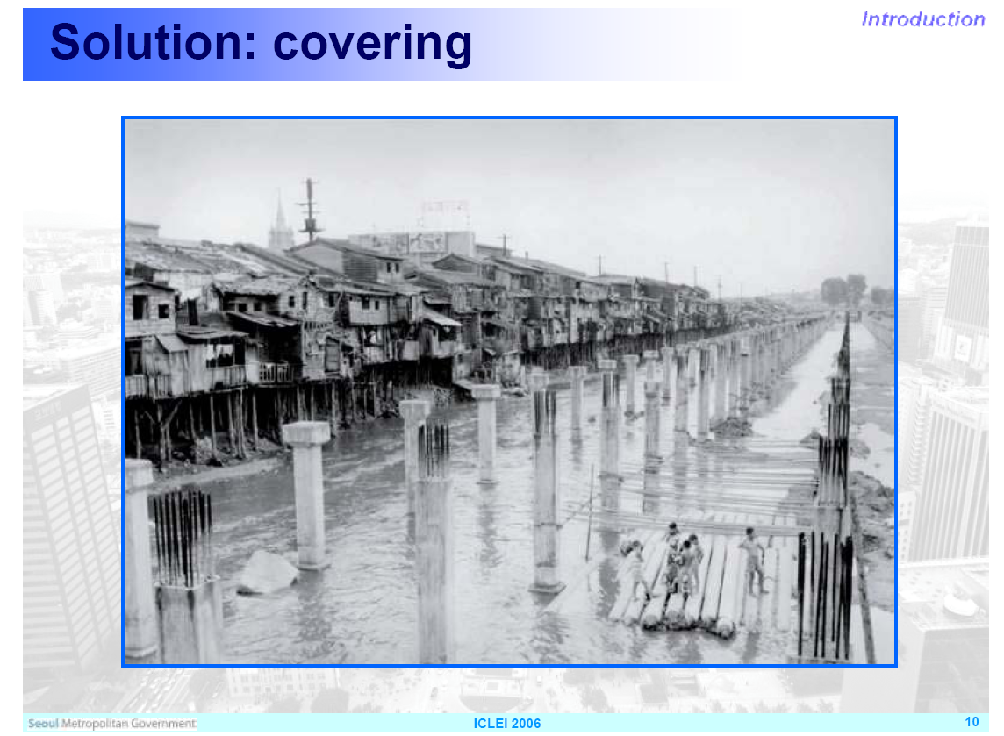

Slide 23
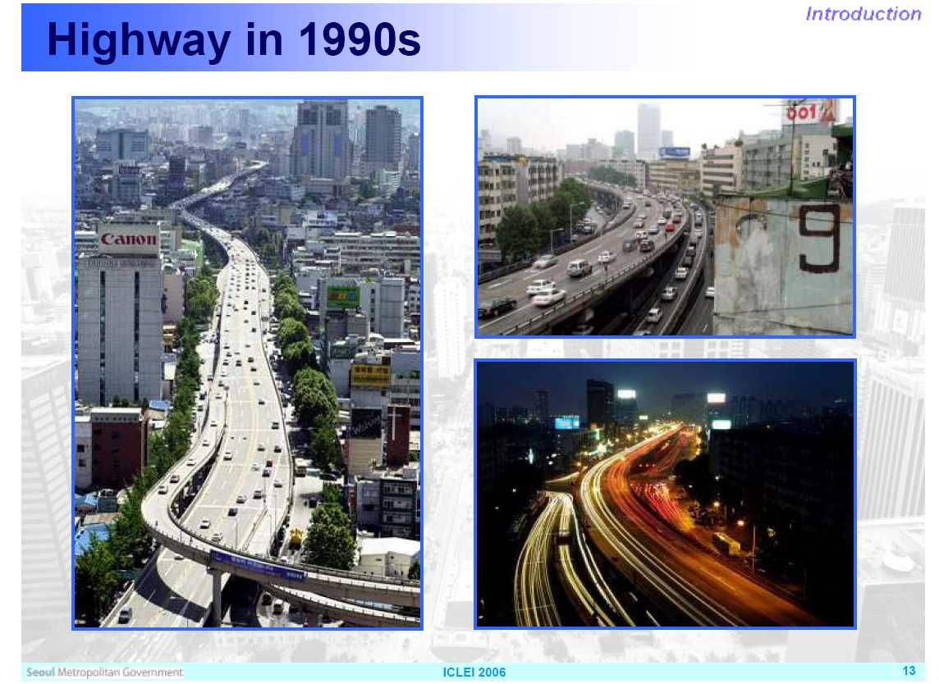

Slide 24
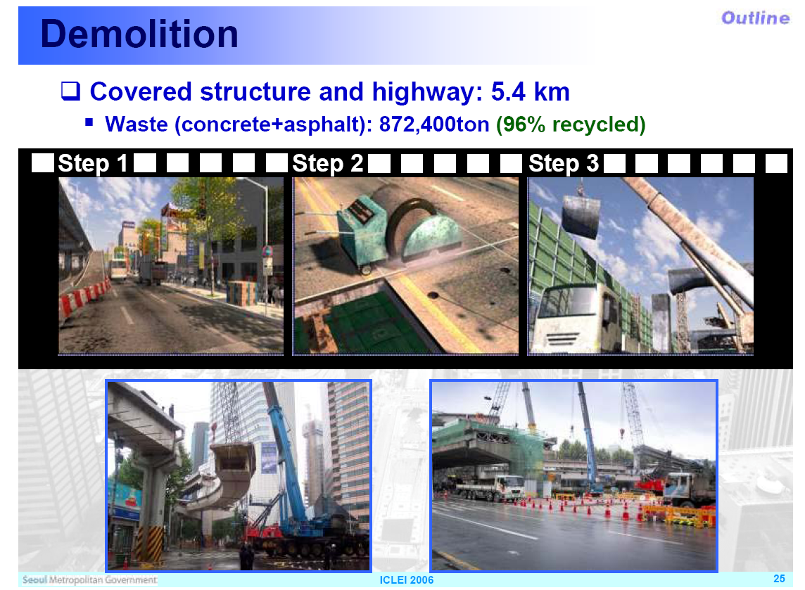

Slide 25
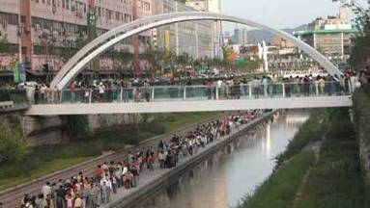
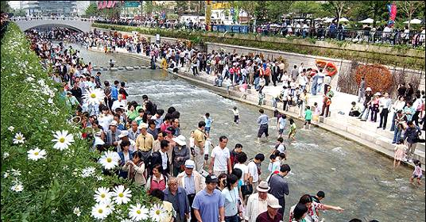
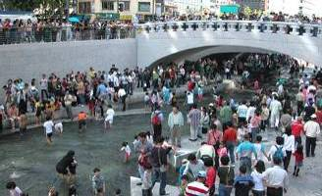
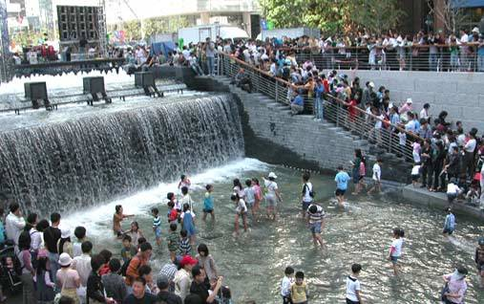
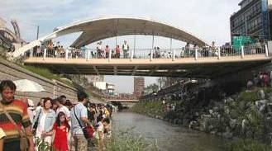
10 million visitors in first 3 months!!!

Slide 26
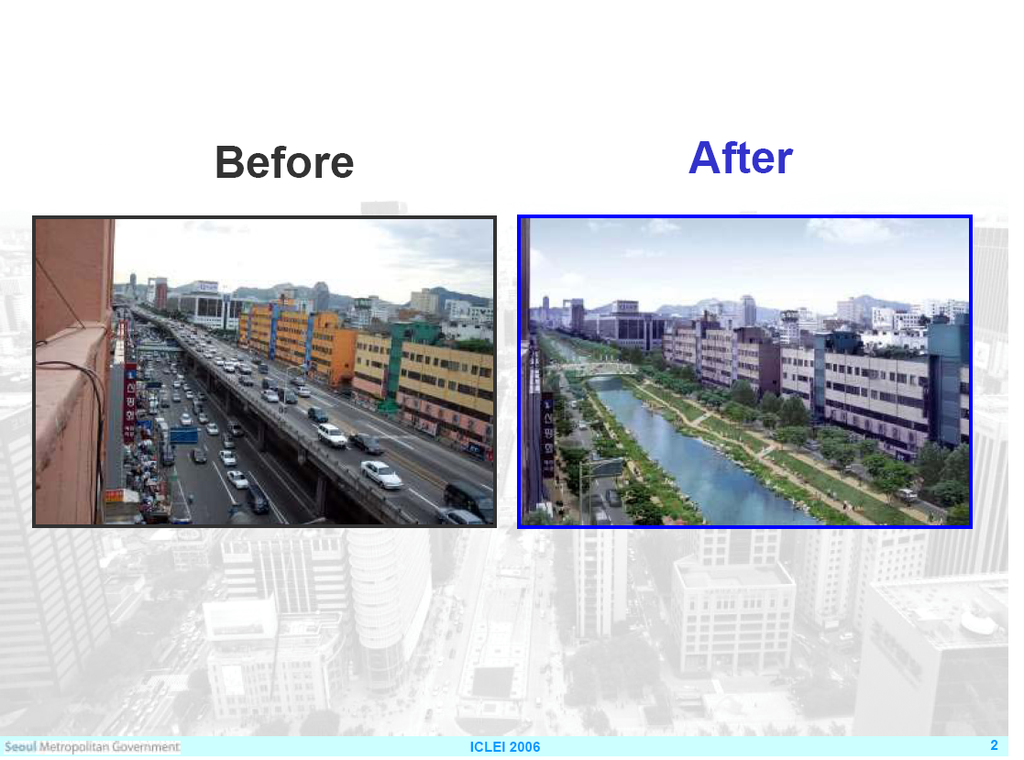

Slide 27
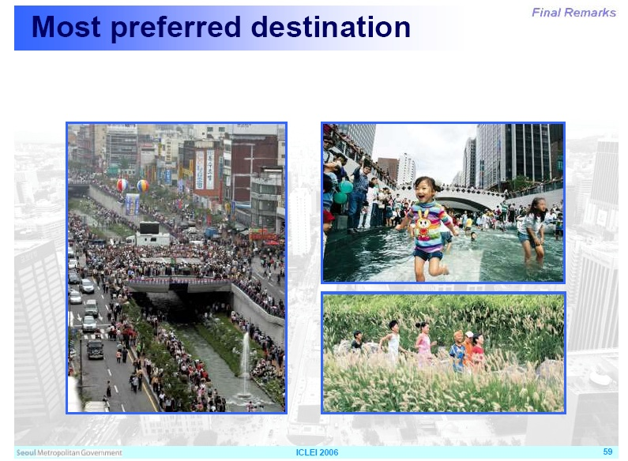

Slide 28
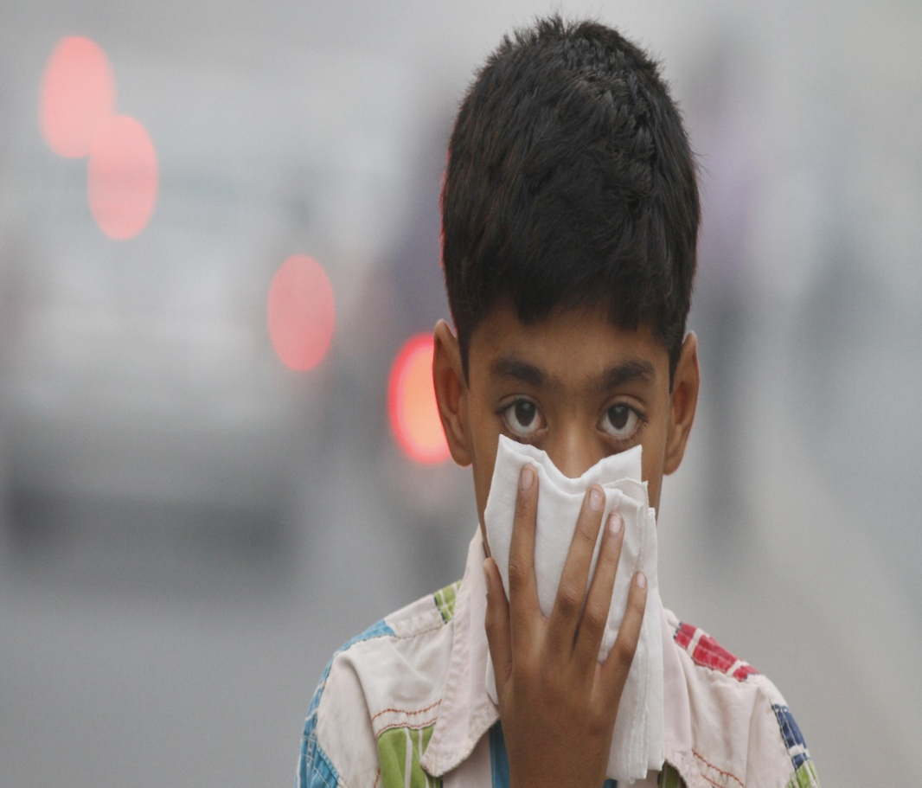
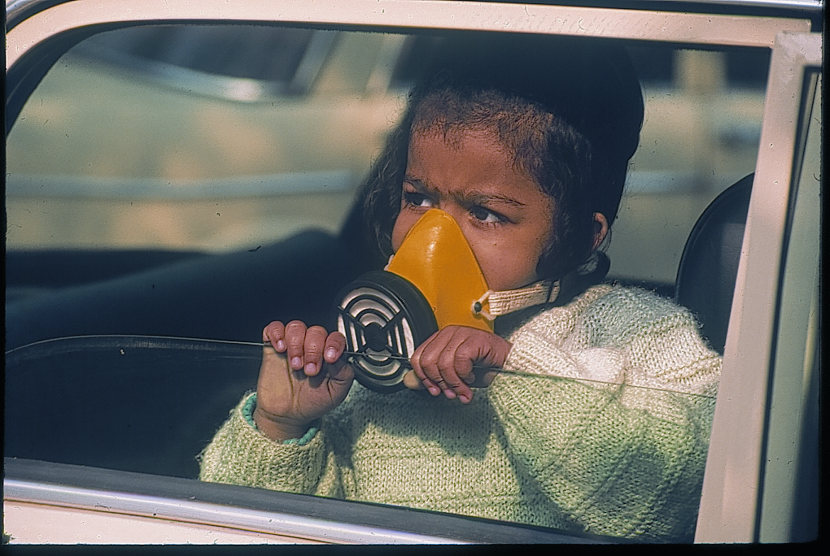
Let’s ‘Be a part of the solution, not part of the pollution, congestion and unsafe road condition’’-at least for the next generation –for the sake of our children

Slide 29
THANKS

